Slide 1



How to become a Knowledge Entrepreneur
Workshop
October 2025

Slide 2
Day 1

Slide 3
Welcome and Procedure

Slide 4
Who are you?
How many semesters have you already studied (Bachelor + Master )?
What is your professional background?
How certain are your future career plans at the moment?

Slide 5
What needs to occur during this workshop for you to consider it a worthwhile investment of your time?
Notes:
Note down responses

Slide 6
Agenda
Day 2
Welcome & Procedure
Introduction to social, digital & environmental challenges and transformation
Coffee break [11:00 – 11.15]
Using design thinking to address chosen challenges
Lunch break [13:00 – 14:00]
Using design thinking to address chosen challenges
Presentation of developed approaches
Reflection on most important vision for own career
Conclusion
Day 1
Welcome & Procedure
Why Knowledge Entrepreneurship?
Successful entrepreneurs: effectual vs. causal reasoning
Coffee break [11:00 – 11:15]
Start with your means: knowledge, skills, abilities & other characteristics
Lunch break [13:00 – 14:00]
Networking strategies
Conclusion and preparation for day 2

Slide 7
Why Knowledge Entrepreneurship?

Slide 8
What is Knowledge Entrepreneurship?
Please go to menti.com and enter this code:
XXXX
Enter the terms/ideas that come to your mind about entrepreneurship
What is the difference between knowledge entrepreneurship and the traditional view on entrepreneurship?
ADD QR Code
Notes:
Mentimeter → write down initial thoughts → Wordcloud
Alternatively: moderation cards, write down and organize
Similarities and differences – which categories emerge?

Slide 9
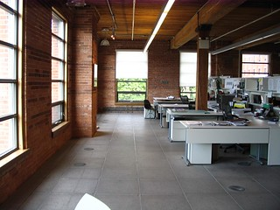
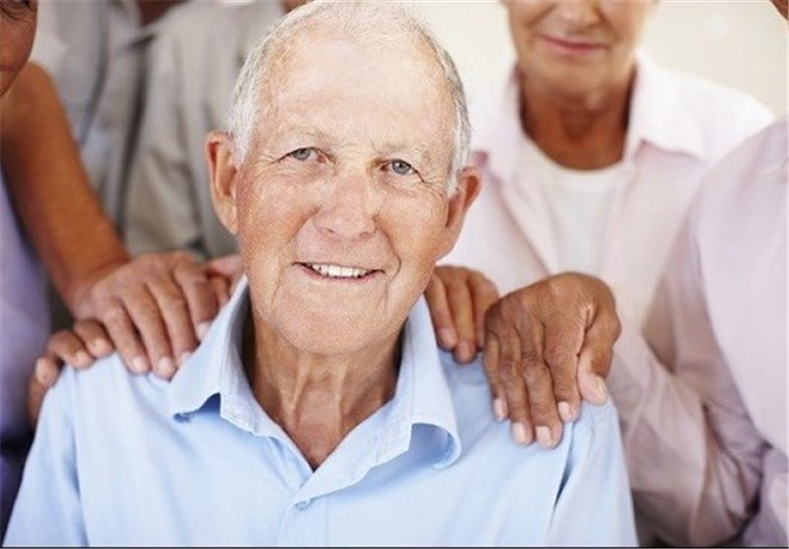
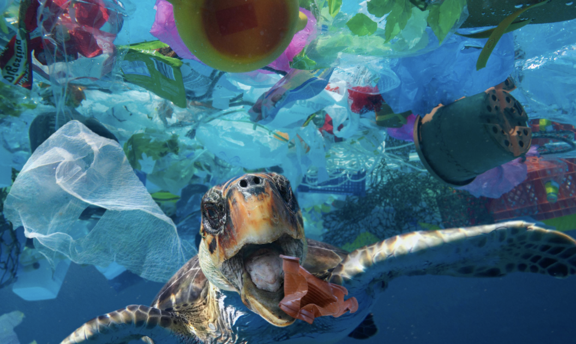

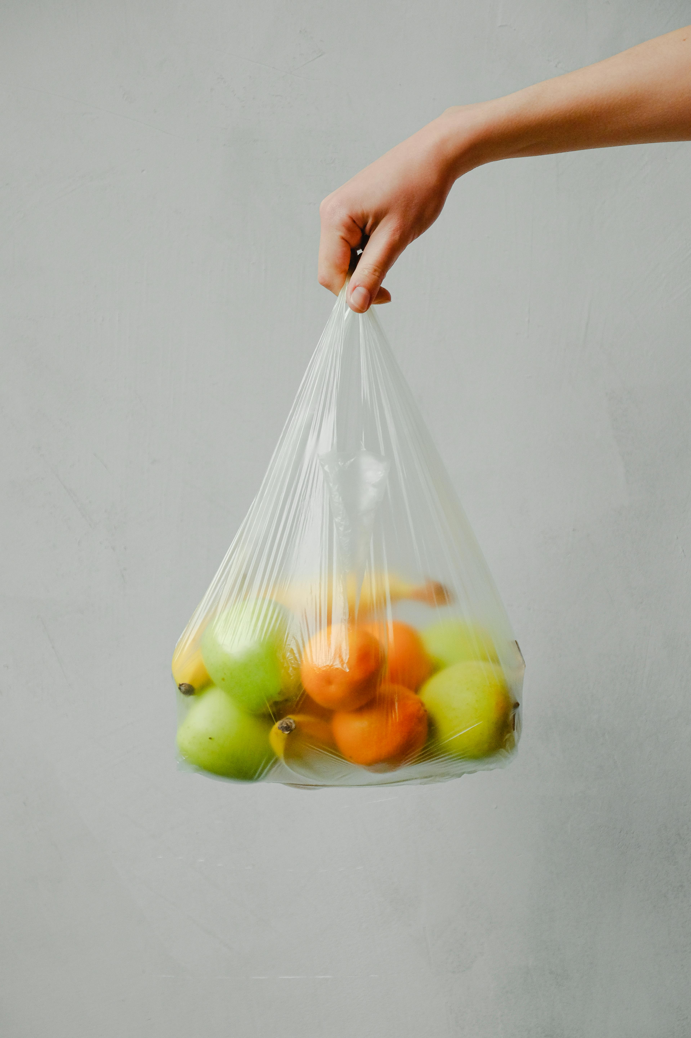
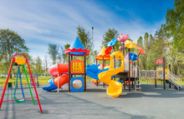
What is “Knowledge Entrepreneurship”?
Increasing challenges (social, environmental, digital) require flexible mindsets and active interventions
"Dieses Foto" is licensed by unknown author under CC BY
"Dieses Foto" is licensed by unknown author under CC BY
"Dieses Foto" is licensed by unknown author under CC BY-SA
Notes:
Examples for challenges:
Supporting the (grand)parent generation and their environment in the use of smartphones and PCs (digital).
An initiative to place a rubbish bin where there is often litter (environmental)
Planning, approval and construction of a new children's playground (social). Regular offers for the population in the form of e.g. podcasts or action groups. -> eigentlich eher working women and childcare challenge

Slide 10

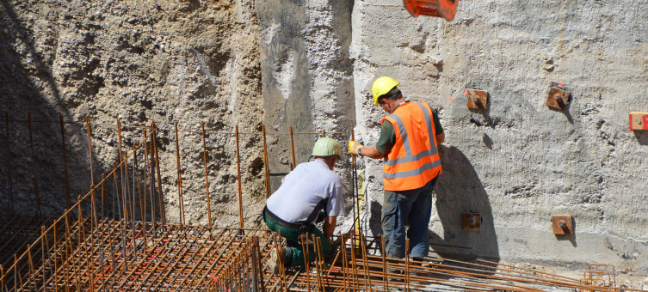
What is “Knowledge Entrepreneurship”?
Simultaneously, there is a challenge of transforming own knowledge and expertise into action
Notes:
Examples for challenges:
Supporting the (grand)parent generation and their environment in the use of smartphones and PCs (digital).
An initiative to place a rubbish bin where there is often litter (environmental)
Planning, approval and construction of a new children's playground (social). Regular offers for the population in the form of e.g. podcasts or action groups.

Slide 11
What is “Knowledge Entrepreneurship”?
Increasing challenges (social, environmental, digital) require flexible mindsets and active interventions
+
Simultaniously, there is a challenge of transforming own knowledge and expertise into action
=
Need for Knowledge Entrepreneurs
Notes:
Examples for challenges:
Supporting the (grand)parent generation and their environment in the use of smartphones and PCs (digital).
An initiative to place a rubbish bin where there is often litter (environmental)
Planning, approval and construction of a new children's playground (social). Regular offers for the population in the form of e.g. podcasts or action groups.

Slide 12
What is „Knowledge Entrepreneurship“?
“Knowledge entrepreneurs are people who use their skills to make an active contribution to society. Through their actions, they help society meet the digital, environmental and social challenges it faces.”
Notes:
Definition of knowledge entrepreneurship
Important:
Utilization of skills and knowledge
Contribution to society (in some cases, founding a company, but not necessarily required)
Goal: Overcoming digital, social, and environmental challenges

Slide 13
Purpose of this workshop
Time and guidance for identifying own knowledge entrepreneurial potential and experiencing first steps of acting as a knowledge entrepreneur

Slide 14
Successful entrepreneurs: effectual vs. causal reasoning

Slide 15
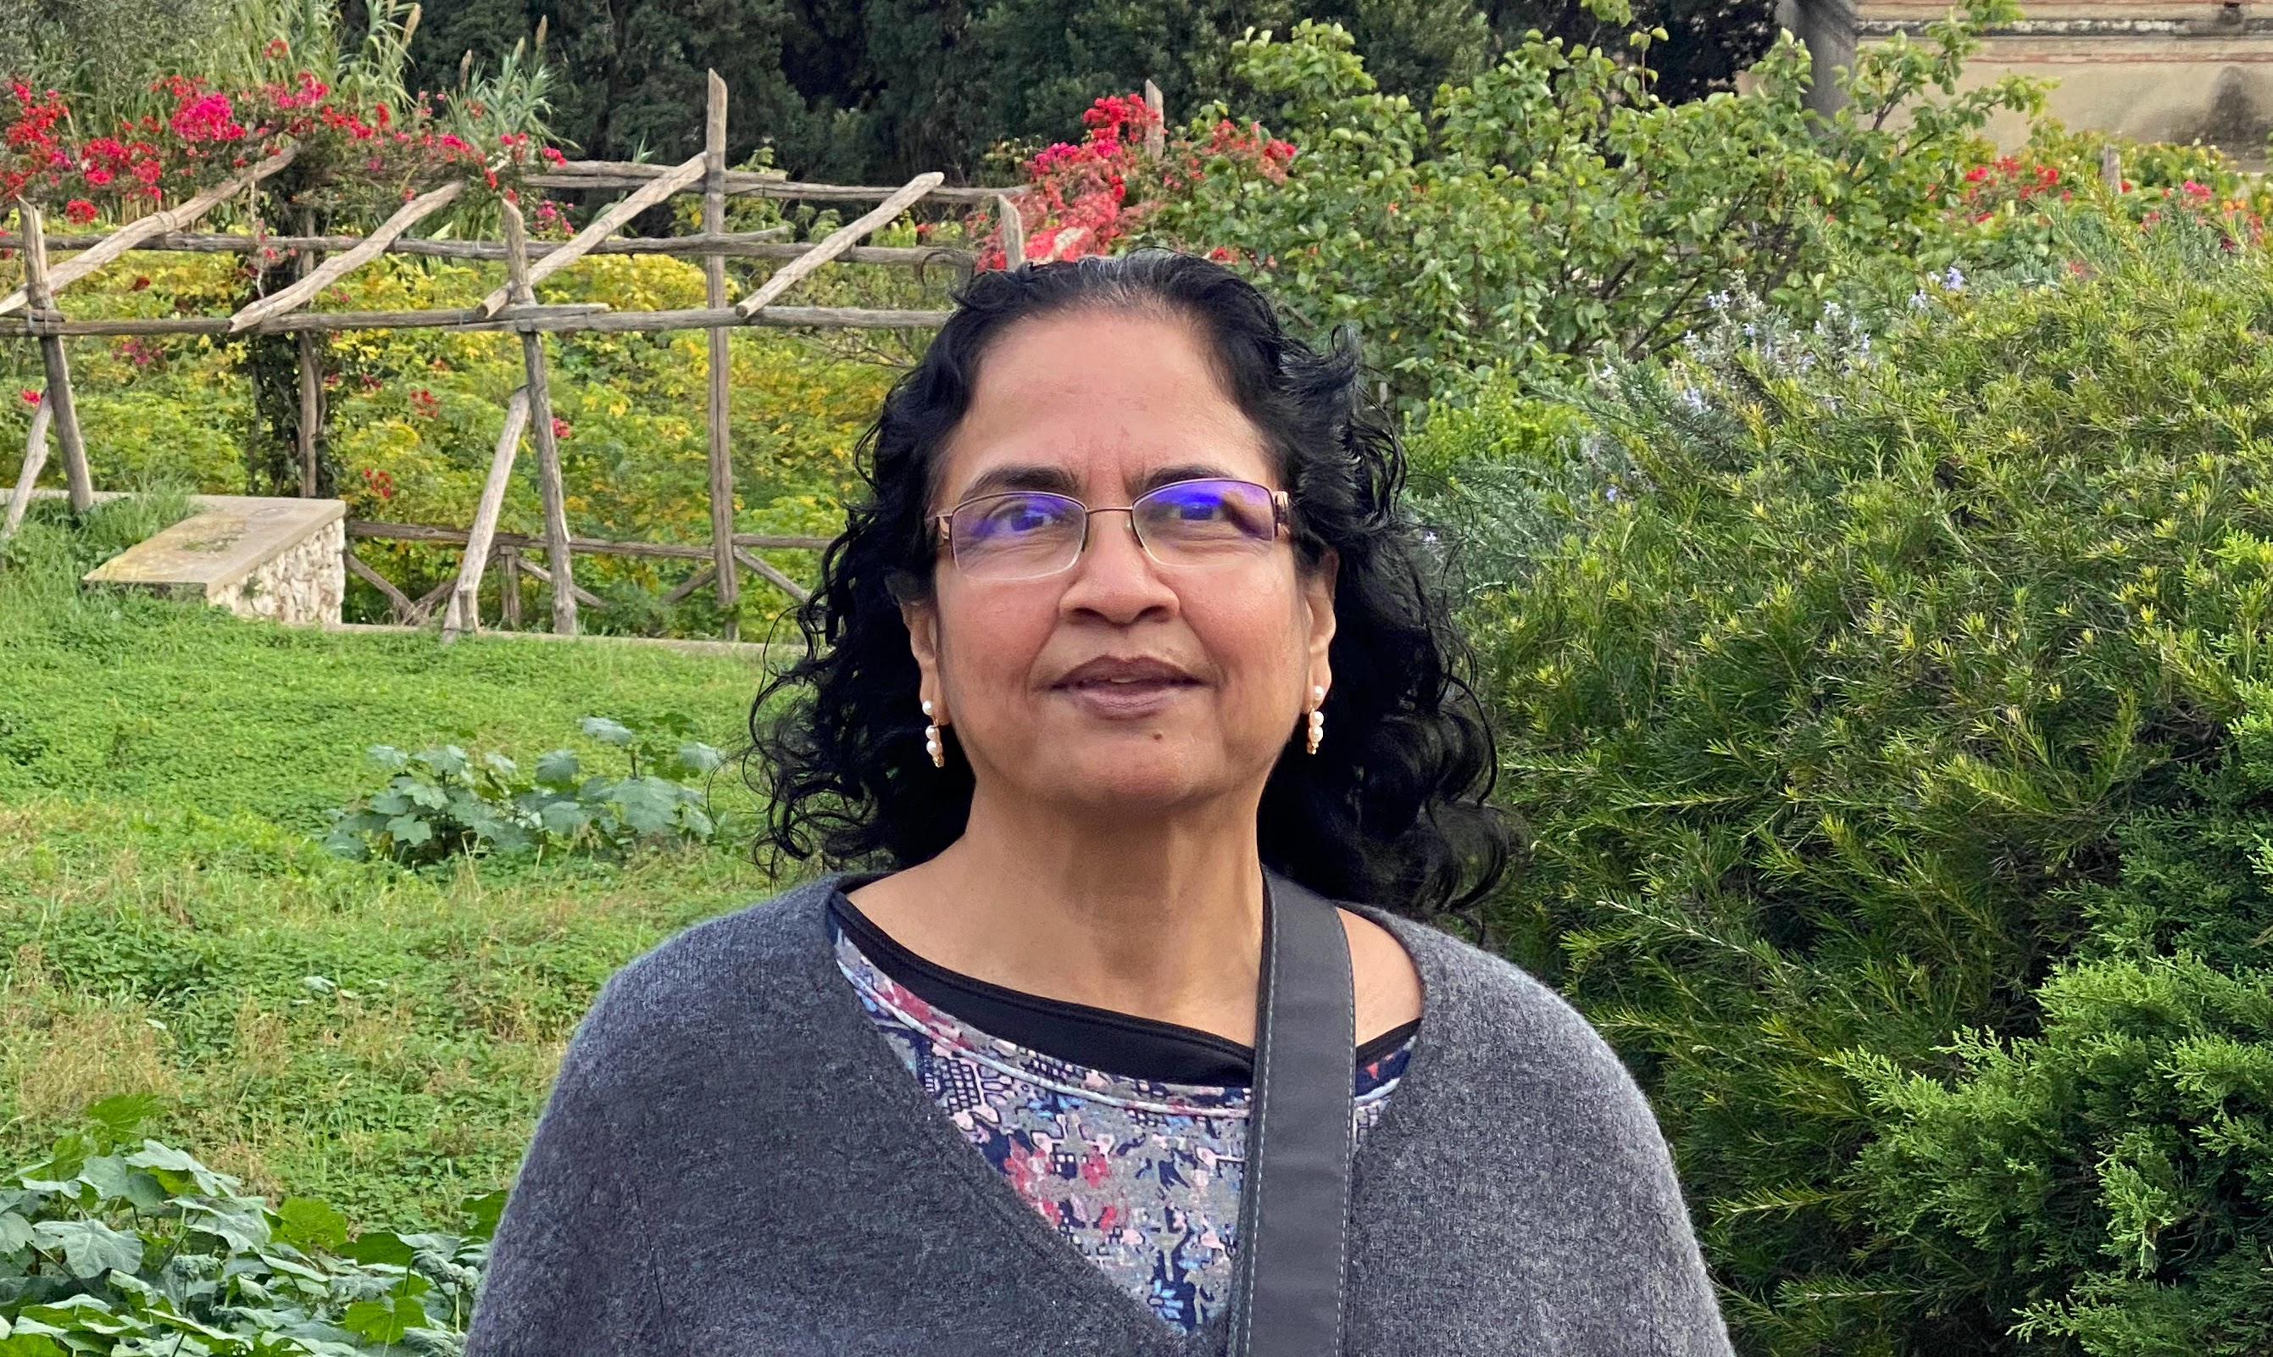
Effectuation
Developed by Prof. Dr. Sara Sarasvathy
  Sarasvathy, S. D. 2001. Causation and Effectuation: Toward a theoretical shift from economic inevitability
  to entrepreneurial contingency, Academy of Management Review, 26(2): 243-288.
Derived from research on Expert-Entrepreneurs
Effectuation =
Entrepreneurial thinking and acting as a proactive, creative, flexible and yet controlled behavior in the face of uncertainty
CalicoJack1682, https://commons.m.wikimedia.org/wiki/File:Saras_Sarasvathy_Photo.jpg#filelinks

Slide 16

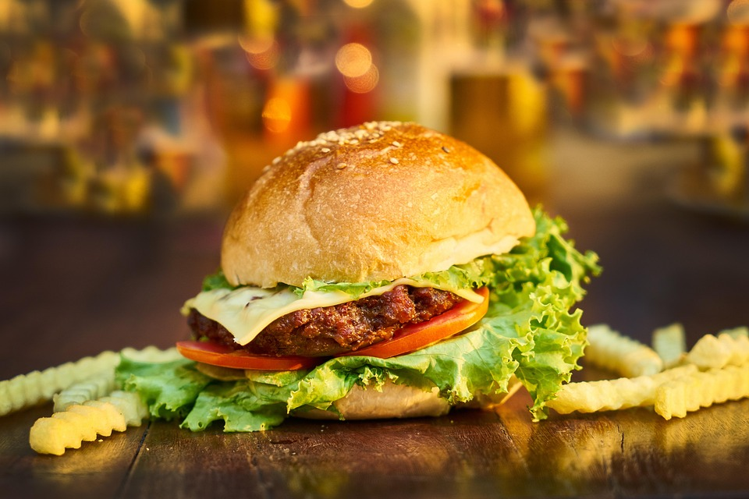
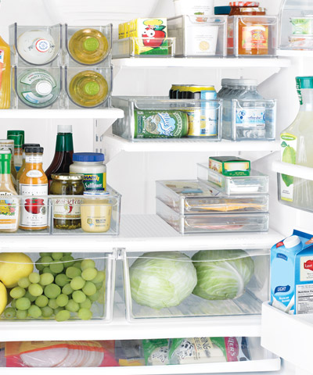
Causation vs. Effectuation
Recipe
Causation
Recipe X leads to result Y
Effectuation
Creative combination of A, B, C leads to result Z
"Dieses Foto" is licensed by unknown author under CC BY-NC-ND

Slide 17
Causal vs. Effectual Reasoning

Slide 18
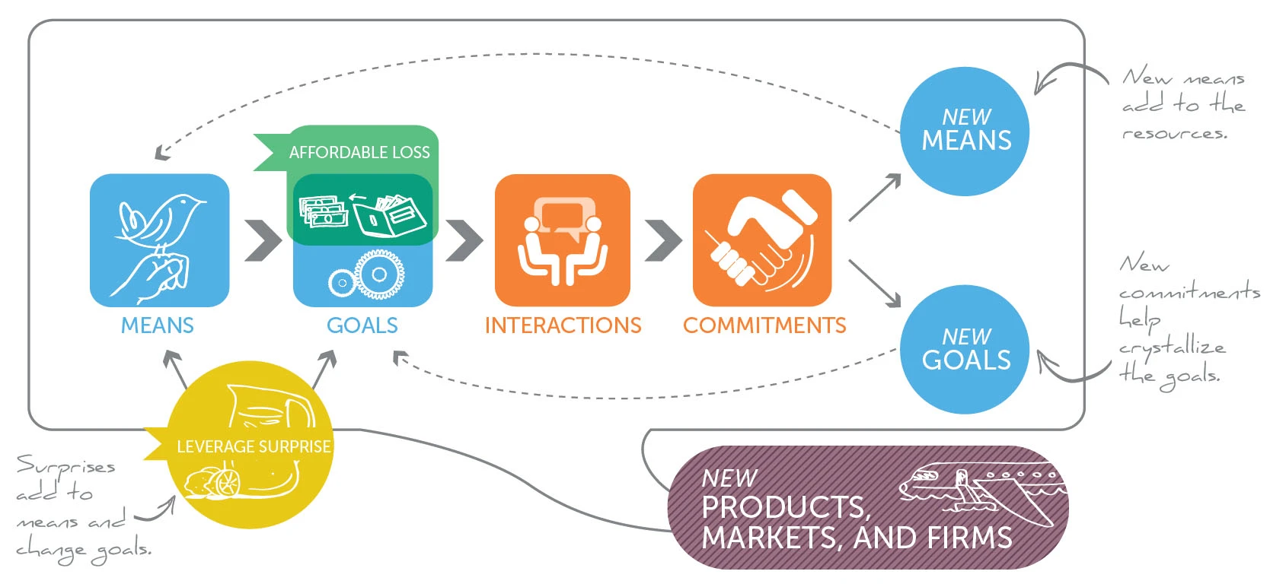
Effectuation circle
Source: https://creativebusinessmodels.com/2019/05/a-creative-entrepreneurial-process/
Notes:
The trainer introduces the distinction between means-driven and goals-driven. The focus should be on existing and known values.
Focusing on goals could lead to problems such as
Big goals do not offer guidance to how to achieve it
Small set goals constrain.
Recommendation: Focus on what is available/means without ignoring

Slide 19
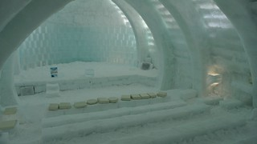
Effectuation STORIES
https://effectuation.org/stories
15 min
"Dieses Foto" von Unbekannter Autor ist lizenziert gemäß CC BY-NC-ND
Notes:
Small groups: Look at the effectuation stories (if you haven't already done so) and then categorize which challenge was addressed (digital, ecological, social) and where you find effectuation stories.
Participants should explain where they find the effectuation principles in the stories they read in preparation. Otherwise, give your own examples.

Slide 20
COFFEE BREAK

Slide 21
Start with your means:
Knowledge, skills, abilities & other characteristics

Slide 22
Effectuation circle
Source: https://creativebusinessmodels.com/2019/05/a-creative-entrepreneurial-process/

Slide 23
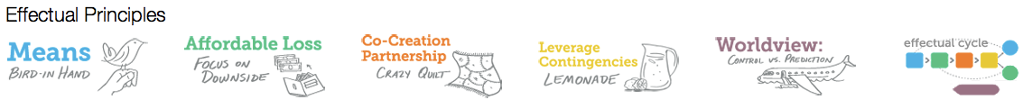
Effectuation principles
1) Who am I? Traits, skills, tastes, …
2) What do I know? Training, education, specific knowledge, …
3) Who do I know? Social and professional networks
Picture Source: https://effectuation.org/the-five-principles-of-effectuation
Notes:
The combination of these three categories leads to opportunity development and goal development.
In this part of the workshop, the participants will focus on the first two categories, the third will be in the focus of the next part of the workshop (Networking)

Slide 24
Who am I and what do I know?
Knowledge, Skills, Abilities & other characteristics (KSAOs)
K
nowledge → theoretical/informational and practical knowledge
Can be learned
S
kills
A
bilities
Difficult to learn
O
ther characteristics → Interests, motives, attitudes, values
Notes:
In occupational and organizational psychology, the first two categories are summarized as KSAOs
Knowledge = the amount of information and knowledge a person has, learnable
Abilities = basic characteristics that are difficult or impossible to learn (e.g., intelligence) that are needed to perform a whole range of tasks (Aamodt, 2010)
Other Characteristics = these usually include personality traits, motivation, interests, etc.
Source: Aamodt, 2010

Slide 25

KSAO - Examples
K
nowledge → Knowledge about tax return, biological processes, ...
S
kills → Driving a car, speak a foreign language, …
A
bilities → Organisational skills, analysis of situations, communication, ...
O
ther characteristics → Political attitude, values, interests, …
10 min
Please fill in the handout „KSAOs“
Notes:
Beispiele für KSAOs

Slide 26
40 min
Exercise: Learning milestones and interview
Please pair up with someone and each partner should write down individually on separate moderation cards important situations where you failed and learned something from it or situations where you had success.
Place these cards on the floor.
Position yourself next to one of the cards with your partner.
Now your partner is the interviewer and asks you questions about the situations.
Use the questions on the handout to understand each other
The interviewer takes notes about their partner´s KSAOs
  Change roles after 20 minutes!
Notes:
Approximately 10–15 minutes
Please continue to write down new insights on pieces of paper
Reflect in a plenary session
Questions Handout:
What happened in this situation?
How did you act in this situation in order to solve the problem?
What was the result?
What did you learn at this point?
Which ability has been helpful in order to solve the situation?
If you would encounter the same situation for a second time, would you change something to be more successfull
Don’t ask questions that can only be answered with yes or no -> instead: Why, what, how!
Summarize what you understood and ask if it was correct!

Slide 27

Reflection on exercise
How was the exercise?
How did you identify the KSAO´s of your partner?
What do you now know about your own means?
https://en.fuckupnights.com/
Notes:
30 minutes maximum, but every couple should have a chance to speak.

Slide 28
LUNCH BREAK

Slide 29
Warm-up

Slide 30






Other characteristics: Personality - Big Five
Openness to experience
Conscientiousness
Agreeableness
Extraversion
Neuroticism
High appreciation for new experiences and variety, inquisitiveness, creativity,
diverse cultural interests
Orderliness, reliability, punctuality, discipline, ambition
Altruism, compassion, benevolence, trust, cooperativeness, compliance, need for harmony.
Sociability, activity, talkativeness, cordiality, optimism, cheerfulness
Nervousness, anxiety, sadness, insecurity, low need control, inappropriate reactions to stress
Notes:
BFI:
self-report personality scale
5 subscales measure 5 personality traits

Slide 31
10 min
Exercise: Personality test
ADD QR Code
e.g.,
http://openpsychometrics.org/tests/IPIP-BFFM/
Notes:
http://openpsychometrics.org/tests/IPIP-BFFM/

Slide 32
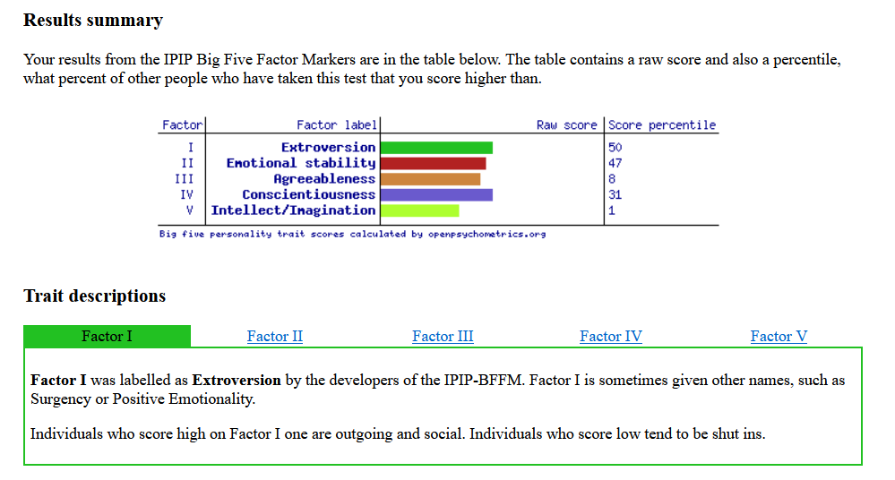
Big Five
Percentile
= a score at or below which a given percentage falls
47% of people score lower in emotional stability
Personality traits are not something ideosyncratic to a person, but only show themselves as the deviation to other persons
Emotional stability

Slide 33

Other characteristics: Interests
Interest = Cognitive involvement/attention devoted to something.
Object of interest: Concrete objects, thematic areas of knowledge, certain classes of activities.
The level of interest is defined by the subjective appreciation of the object of interest and how positive the associated emotional states are.
Notes:
Objects: Balls, books, computers, engines/machines
Thematic areas: Psychology, Music, Mathematics
Activities: Sports (playing soccer or tennis), traveling, making/listening to music

Slide 34
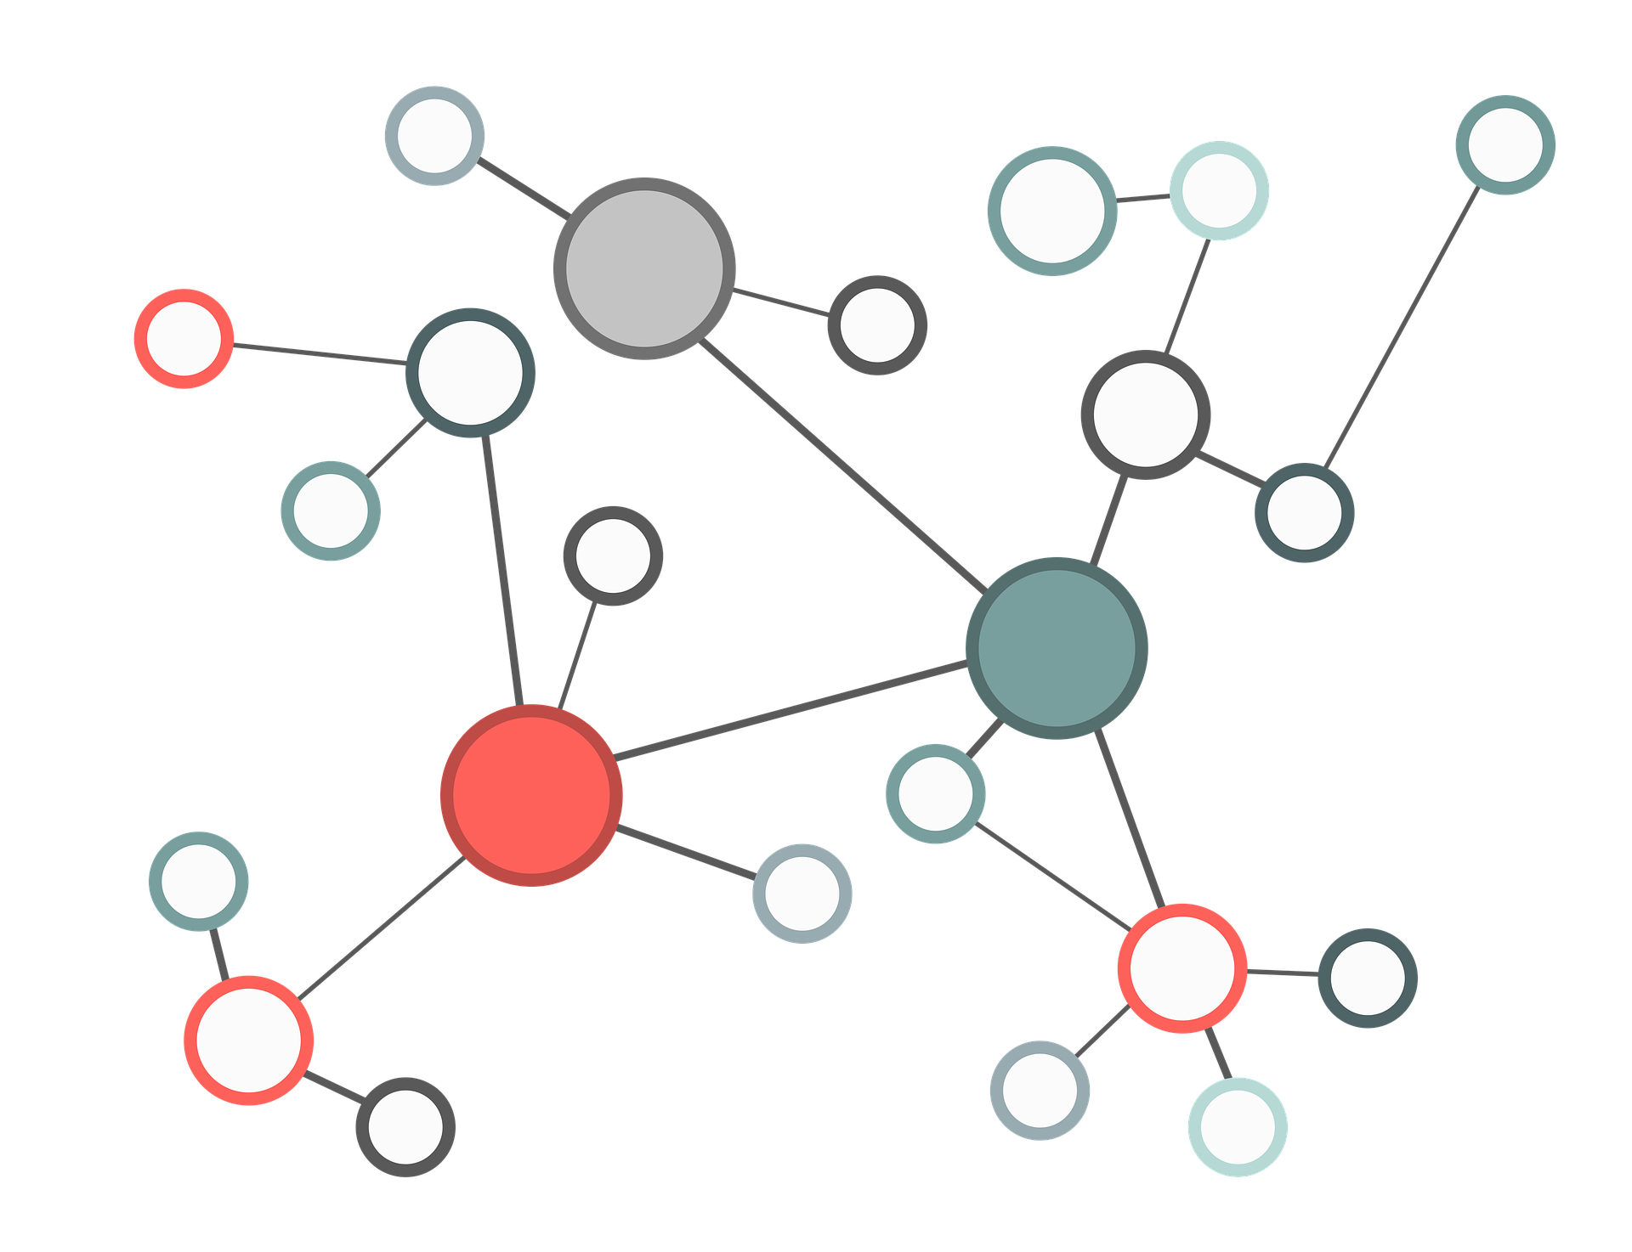
15 min
Exercise: Interests
1. Draw a mind map - roughly, and anything that comes to mind
  What catches your interest?
  In which topics/fields are you interested in?
2. Draw a new mind map and sort themes
  Is there a thread across the areas?
  What themes are recurring themes?

Slide 35
10 min
Your future as knowledge entrepreneur
Exercise
Vision journey!
Notes:
Recap – what have you learned about yourselves?
Introduction: Introduce this exercise carefully – you don't want the TLNs to think it's some kind of psycho mumbo jumbo! Explain what the exercise is and what it's for.
Please take notes answering the following questions. Those who prefer to close their eyes can do so.
We start the Vision Journey and jump a few years into the future: Your project as knowledge entrepreneur has turned out better than you could have ever dreamed. What exactly happened to make the project so great? Let your imagination run wild, you are not bound by probabilities.
You are working on the project: What are you doing? Where are you? What does your workplace look like? What do you see, what do you hear, what do you feel?
Now you have a team meeting: what does it look like and what is your role in the best team ever?
Now your working day is coming to an end. You go out and meet a friend you haven't seen for a while. She asks you about your work and you talk about how everything went really well - what exactly do you talk about? What is most important to you?
Back home you get the news that a major magazine has written about the project and your work. Full of anticipation you click on the link - what does the article say?
What is your basic feeling? Listen to yourself and try to find some terms that describe your feelings well.

Slide 36
Your future as knowledge entrepreneur
Exercise
Note down the most important points of your vision:
  What do you remember?
  What was important in relation to your project as a knowledge entrepreneur?
  Did you learn anything specific from the experience?
Notes:
Take some more time to note down the most important learnings from this vision journey

Slide 37
Networking strategies

Slide 38
15 min
Exercise: Network!
Write down 3 Questions nobody has ever asked you
Walk through the room.
When you meet someone:
  Ask each other your questions
  Exchange one of your card
  Talk about your societal, ecological and digital transformation/problem
You should talk to everyone at least once!

Slide 39
Effectuation principles
1) Who am I? Traits, skills, tastes, …
2) What do I know? Training, education, specific knowledge, …
3) Who do I know? Social and professional networks
Picture Source: https://effectuation.org/the-five-principles-of-effectuation

Slide 40










Networking
Networking is building relationships before you need them. Then when you need them, you will know whom to call and he or she will want to help you. (Darling, 2003)
Notes:
Goals:
Participants understand why networking can create new means
Participants know what networking is
Participants know their own network and identified gaps
Participants know their own challenges when it comes to networking
Participants are able to use different networking strategies that fit to their personality and know how to apply them to future networking plans

Slide 41
Exercise
In what situation did you network successfully in the past?

Slide 42
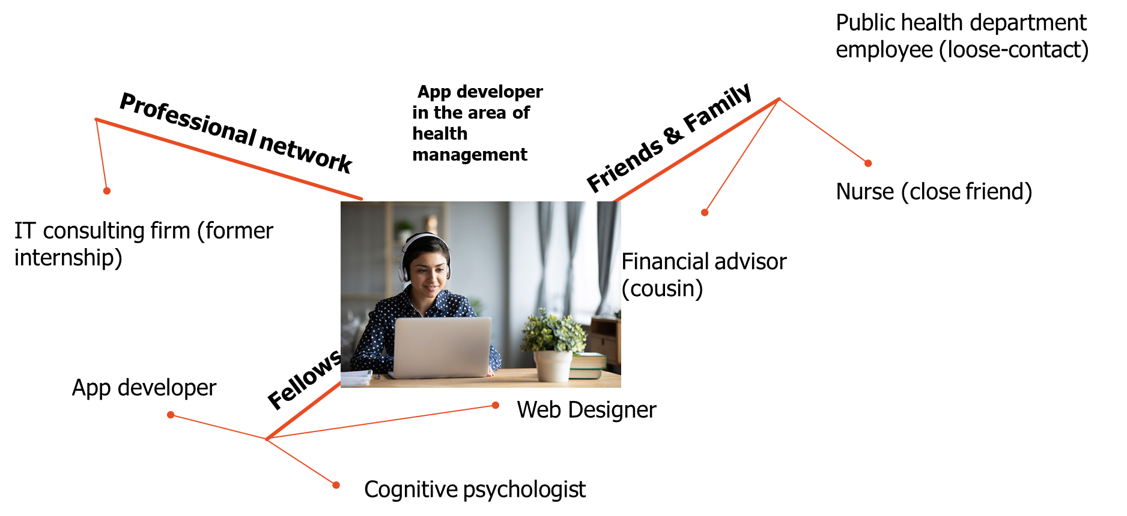
Example: Paula is an app developer in the area of health management
Notes:
Give examples

Slide 43


10 min
Exercise: Who in your network is relevant to your vision as a knowledge entrepreneur?
Your contacts (e.g. social media)
Classmates, alumni
The strangers in your life
...
Gaps?!
Please fill in the handout “Networking”
Notes:
Go into a group with someone you DO NOT KNOW yet
Goal: Find out your network for the next career step (applying for a job)

Slide 44
10 + 10 min
Exercise: INTERVIEW
Ask each other the following questions:
  Who are the persons?
  Who is important for your vision?
  Why is he/she important?
  How is the current contact?
  What is your goal concerning future contacts? (Who is still missing in your network?)
  What have you already done to get in touch with these people?
  What could be done?
Notes:
Questions should be photographed beforehand -> Then you can walk around campus and ask each other questions.

Slide 45
Reflection of exercise
How was the exercise?
What gaps did you identify?
What are your strategies to close these gaps?

Slide 46
Networking – steps to establish new contacts
Identify a goal (e.g., why do you want to get in touch with someone/ How can he/she be useful?)
Get to know your counterpart (ask questions and present yourself)
Establish a relationship (e.g., similar interests)
Take your time - contacts need to grow
Offer added value to your interlocutors
Communicate your concerns openly – be authentic
Maintain the contact (e.g., find follow up reasons)

Slide 47
10 min
Exercise:
What kind of contacts do you need for you vision as knowledge entrepreneur?
Define a goal for networking with the people from this course or for the next week!
Notes:
Participants should think briefly, take notes, and then share their results.

Slide 48
Conclusion and preparation for day 2

Slide 49
What do you take home?
Knowledge Entrepreneurship
Effectuation
Start with your means
Networking

Slide 50
Day 2

Slide 51
10 min
Warm-up: Equilateral triangle
Notes:
Participants should find two other Participants with whom they form an isosceles triangle. They are not allowed to talk. The exercise continues until everyone has formed a triangle (preferably in a place where there is enough space). Afterwards, ask who the partners were.
Transition: In this exercise, everyone moves when just one person changes their position -> Everyone has an influence on the overall system and thus also on the transformations that will now be explained again.

Slide 52
Agenda
Day 2
Welcome & Procedure
Introduction to social, digital & environmental challenges and transformation
Coffee break [11:00 – 11.15]
Using design thinking to address chosen challenges
Lunch break [13:00 – 14:00]
Using design thinking to address chosen challenges
Presentation of developed approaches
Reflection on most important vision for own career
Conclusion
Day 1
Welcome & Procedure
Why Knowledge Entrepreneurship?
Successful entrepreneurs: effectual vs. causal reasoning
Coffee break [11:00 – 11:15]
Start with your means: knowledge, skills, abilities & other characteristics
Lunch break [13:00 – 14:00]
Networking strategies
Conclusion and preparation for day 2

Slide 53
Societal, ecological and digital challenges and transformations and introduction to design thinking

Slide 54
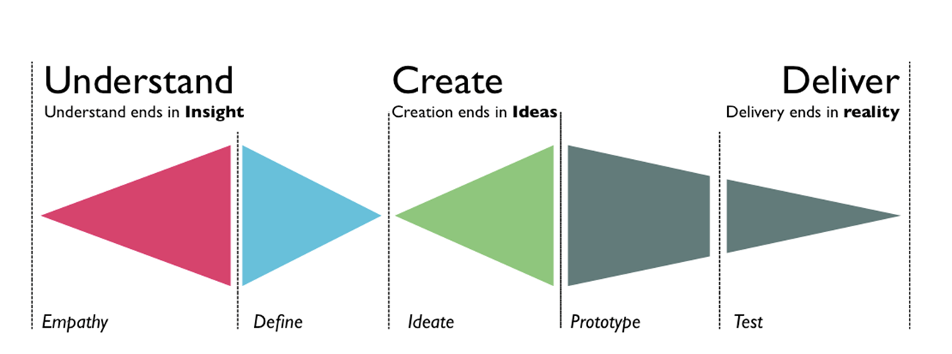
Design Thinking:
Process of flexible thinking to develop solutions for a specific problem
Diverge and discover
Converge and define
Diverge and develop
Converge and deliver

Slide 55
Design Thinking
Design thinking is an agile approach that can be used to solve problems in a variety of contexts.
Notes:
Empathize: talk to other people, learn about their problems, etc.
Define: clearly define the challenges together
Ideate: brainstorm possible solutions to the challenges
Prototype: create an initial version of a solution that can be tested
Test: test this prototype

Slide 56
Empathize
Societal
Ecological
Transformation
Digital
Notes:
15 min

Slide 57
Examples of societal transformations
Globalization and global trade (economic relation, e.g., role of China and Europe)
Changes in social roles (e.g., gender roles, demographic change in the age distribution)
Social conflict (migration, war)
Urbanization

Slide 58
Examples of ecological transformations
Environmental protection (transportation, circular economy)
Climate change (extreme weather events, heatings, floodings)
Change in nutrition behavior

Slide 59
Examples of digital transformations
Ubiquitous computing → physical and digital spaces are merging (e.g., Chat GPT)
Digital footprint → Behavior leads to data (e.g. amazon recommendations)
Partial replacement of existing structures with computer-based or fully digital processes

Slide 60
5 min
Exercise: Empathize and identify problems
Societal
Ecological
Transformation
Digital
Gather in groups of 3-4 members
As a group, brainstorm as many problems as you can that are caused by these transformations (only key words)!
Notes:
Max. 4 participants per group
Write on a flipchart

Slide 61
Exercise: Gallery walk
Take a look at the ideas that other groups brainstormed

Slide 62
Design Thinking
Design thinking is an agile approach that can be used to solve problems in a variety of contexts.
Notes:
Empathize: talk to other people, learn about their problems, etc.
Define: clearly define the challenges together
Ideate: brainstorm possible solutions to the challenges
Prototype: create an initial version of a solution that can be tested
Test: test this prototype

Slide 63
30 min
Exercise: Define challenging transformations
Societal
Digital
Ecological
Define 1 challenging problem more precisly:
Specify:
  Who is involved in this problem?
  What are the needs of these people?
  What is the cause of the problem?
  Why does this problem persist?
  Write down a concrete problem statement!
Use all devices and resources you have for your research (Internet, prior knowledge, etc.)
Notes:
No solutions!
Problem statement
Specify:
A problem statement
Person concerned / target market
Needs
Goal

Slide 64
Presentation of results
Audience takes notes on:
USERS
NEED TO
BECAUSE OF
Notes:
40 min
Participants present their results and the rest of the group should try to understand what kind of problem they identified. The audience should formulate one sentence of what they understood from the presentation (see above).

Slide 65
Decide if you want to change your group and decide on a problem you want to work on

Slide 66
COFFEE BREAK

Slide 67
Ideation

Slide 68
Design Thinking
Design thinking is an agile approach that can be used to solve problems in a variety of contexts.
Notes:
Empathize: talk to other people, learn about their problems, etc.
Define: clearly define the challenges together
Ideate: brainstorm possible solutions to the challenges
Prototype: create an initial version of a solution that can be tested
Test: test this prototype

Slide 69

Creativity exercise
Find as many examples as possible for what a brick can be used for
Notes:
together

Slide 70
Creativity
Fluency
Defined by the number of creative ideas that you have
Originality
Defined by the number of creative ideas you share with other people (probability of an idea)

Slide 71
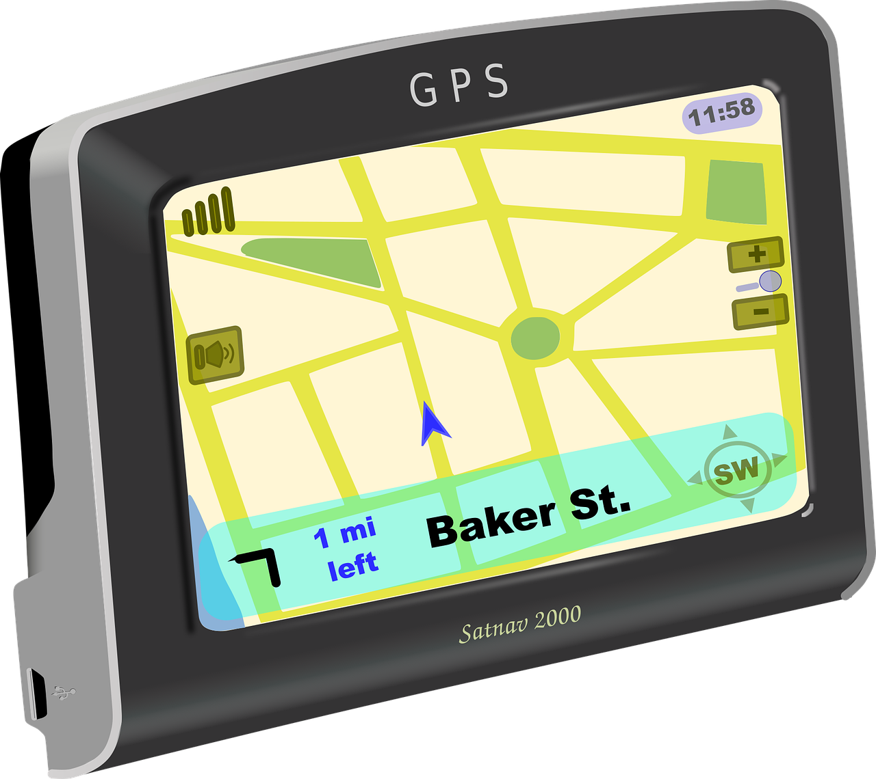


Ideation / Creativity
Many people think that they are not creative at all
Creativity can be learned & ideas are not a coincidence but can emerge from a structured process and the use of different creativity tools
What is a creative idea? New ideas often come from new connections of already known contents à e.g., new combination of 2 terms leads to a solution idea. It should be something new and useful
+
=
"Dieses Foto" was licensed from unknown author by CC BY

Slide 72

A creative idea...
needs time.
combines several already known things.
is not a coincidence.
needs feedback.
does not come by sitting still and thinking!
"Dieses Foto was licensed by unknown author under CC BY-SA-NC
Notes:
First point: So don’t select your favourite idea from the start! Good ideas benefit from an open mindset.

Slide 73
10 min
Exercise Ideation: 4 – 3 – 2 (Gathering Stage)
4 person
3 ideas
2 rounds
Write down three ideas on the sheet
Hand your sheet of paper over to your partner on the left hand side
The sheets will circulate around for two rounds

Slide 74

10 min
Exercise: VIP
Get together in groups of 3-4 members
Think about 1 VIP/celebrity that all of the group members are familiar with
Collect ideas how this VIP would solve your problem
Present your ideas to the other groups

Slide 75
10 min
Exercise (within groups): Selection – Post-It Comparison
Select the best idea of the list on the sheet of paper that lies in front of you (Criterion: idea fits to your means)
Write this idea on a post-it
Align the post-its of all group members on the table
Compare the first idea with the second one and agree which idea is better according to your team´s means
Swap the ideas if necessary
Continue to rank order all ideas, by comparing one by one
Notes:
Show on a flipchart

Slide 76
Presentation of results: Explain why you selected your idea!
Notes:
Approx. 30 min
Make sure that the participants really choose ideas that match their abilities.

Slide 77
LUNCH BREAK

Slide 78
Application - Prototyping

Slide 79
Design Thinking
Design thinking is an agile approach that can be used to solve problems in a variety of contexts.
Notes:
Empathize: talk to other people, learn about their problems, etc.
Define: clearly define the challenges together
Ideate: brainstorm possible solutions to the challenges
Prototype: create an initial version of a solution that can be tested
Test: test this prototype

Slide 80
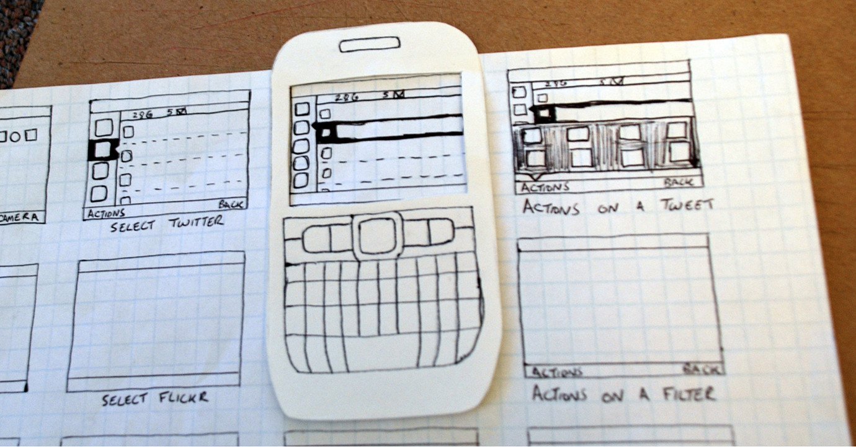
Prototyping
Prototypes = First example of an idea (product, service etc.), from which all later forms are developed
"Dieses Foto" was licensed by unknow author under CC BY-SA

Slide 81

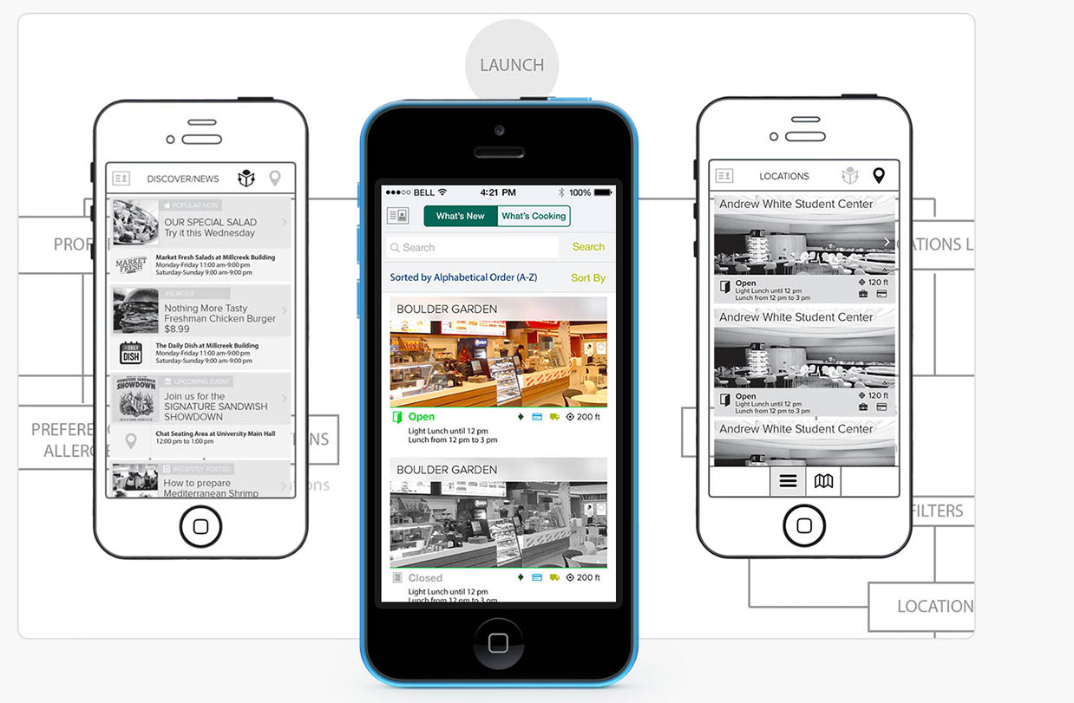
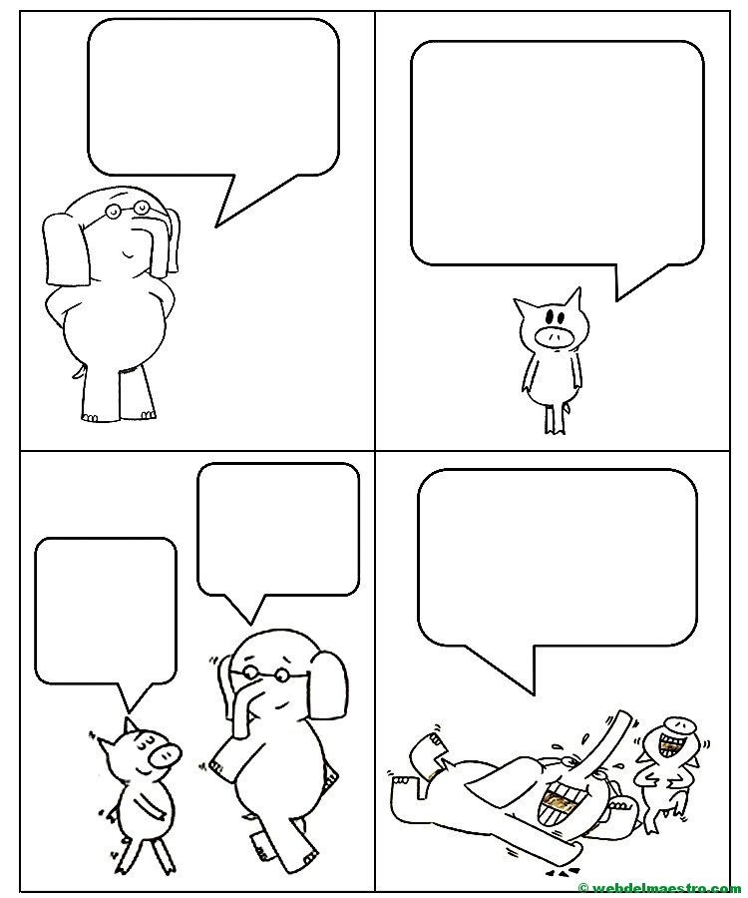

Paper
Examples
Video
Click Dummy
"Dieses Foto" was licensed by unknown author under CC BY-SA
Comic
"Dieses Foto" was licensed by unknown author under CC BY-SA
Tinkering
"Dieses Foto" was licensed by unknown author under
CC BY-SA-NC
"Dieses Foto" was licensed by unknown author under CC BY-NC-ND

Slide 82
60 min
Exercise: Protoyping
Develop a first version/prototype to solve the chosen challenge.
Feel free to use the different materials
  Flipcharts
  Moderation cards
  Scissors, glue, pens
  Lego
  PowerPoint ...
Afterwards: Presentation of the prototypes in the plenum & feedback (decide who is going to present the prototype)
Notes:
Think back to this morning/yesterday—what KSAOs do you have that you can use? What contacts would you need/use?

Slide 83
Steps for developing your product / service
What is the benefit of your product for your target group?
In what way does your product / service fit the needs of your target market
In what manner is your product / service new, innovative in comparison to other already existing products?
Is your business idea realistic / feasible?
Why does your product / service match your team´s means (skills, resources, network)?
Notes:
Show this slide while everyone develops their prototype -> Important: don't just develop prototypes, but also prepare a presentation about your start-up idea/product that answers the questions above.

Slide 84
Presentation of prototypes

Slide 85
Evaluation criteria
Value proposition
Target market fit
Innovativeness
Feasibility
Match to team´s means
++
… perfect!
+
… okay!
~
… needs time for more reflection
Notes:
Participants receive cards (scale 1-3) and are asked to briefly evaluate the criteria after each presentation by selecting a card.
Trainer adds up the points and asks specific participants why they would give the selected number of points.
Feedback on the ideas is welcome.

Slide 86
Conclusion and Feedback
Notes:
hat has been your experiences throughout the day?
Do you think that you are a creative person or not?
How did you like the design thinking approach?

Slide 87
Conclusion
Knowledge Entrepreneurship
Start with your means: KSAOs
Networking
Societal, ecological and digital transformations
Design Thinking: Empathizing
Design Thinking: Definition
Design Thinking: Ideatation
Design Thinking: Prototyping
Notes:
DV

Slide 88
Feedback
What did you like best?
What will you take home?
What can we improve?
What can be omitted next time?

Slide 89
Questions?
Notes:
DV

Slide 90
Thank you for your attention

