Slide 1
Gender in Agrifood Systems Teaching
Date
Facilitator’s name and email address
Notes:
After the introduction of the facilitator and a brief presentation of the Agrigep project (to be designed by the facilitator if considered), it is recommended to highlight some EU policies that show the relevance of the topic from a decision-making point of view. Some key EU policies:
1995 Beijing conference where the word ‘gender’ appeared for the first time,
2007 Council of Europe issued a recommendation on gender mainstreaming in education,
2015 Paris declaration and Commission/Council for non-discrimination,
2015 launched and adopted the European Framework for Education 2030 equal opportunity for all, guidelines started to appear
Be sure that the audience know the difference between sex and gender.

Slide 2
Glossary
Gender Balance: An equitable distribution of genders within a group, organization, or team, often with the goal of fostering diverse perspectives and reducing bias.
Gender Barriers: Obstacles that limit opportunities, resources, or fair treatment based on gender, often rooted in societal norms or institutional practices.
Gender-Based Violence: Any act of violence directed at an individual based on their gender, often intended to establish or reinforce gender-based power inequalities.
Gender Dimension: The integration of gender considerations into the design, implementation, and evaluation of policies, projects, or research to ensure that they benefit all genders fairly.
Gender Equality: The state of equal access to opportunities and resources, regardless of gender, aiming to eliminate gender-based discrimination and ensure fair treatment for all.​
Gender Equality Plan (GEP): A formal policy or document developed by an organization to promote equal opportunities and eliminate gender bias within the workplace or project environment.​
Gender Impact: The specific effects or outcomes that an action, policy, or program has on gender equality or the experiences of different genders.​
Gender Inequalities: Disparities in status, resources, opportunities, and treatment based on gender, often resulting from systemic biases or discrimination.​
​

Slide 3
Glossary
Gender Mainstreaming: A strategy in which gender perspectives are integrated into all stages of project planning, implementation, and evaluation, promoting equal opportunities and preventing gender-based discrimination.
Gender Quotas: A system of setting minimum requirements for gender representation in certain areas, such as employment or decision-making bodies, to promote gender equality.
Gendered Metaphors: Figurative language that reinforces gender stereotypes or assigns gendered characteristics to certain roles, objects, or actions.
Language Bias: The use of language that reinforces stereotypes or excludes certain groups, often unintentionally; this can include gendered terms or phrasing that favor one gender over another.
Mitigating Measures: Actions taken to reduce or counteract potential negative effects, such as policies or practices aimed at lessening gender-based barriers or biases.
Sexual Harassment: Unwanted or inappropriate behavior of a sexual nature that creates an intimidating, hostile, or offensive environment for the victim.
Unconscious Gender Biases: Implicit biases specifically related to gender, which can influence perceptions, decisions, and behaviors without conscious awareness, often perpetuating stereotypes and inequalities.
​

Slide 4
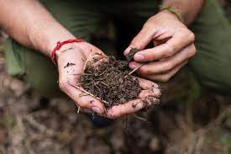

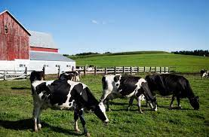
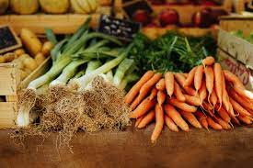
Contents
Agrifood systems context
Gender in teaching
Agrifood systems examples
Recommended readings
Final remarks

Slide 5
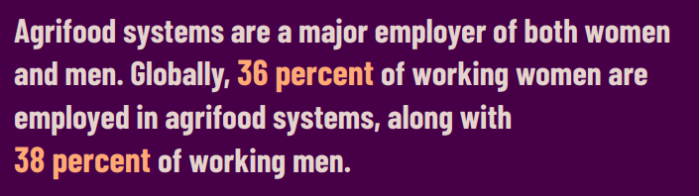
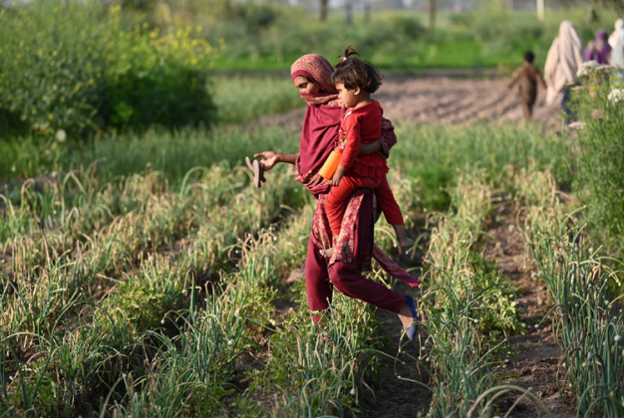

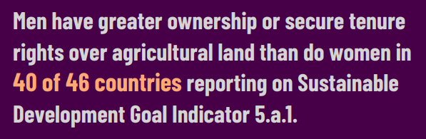
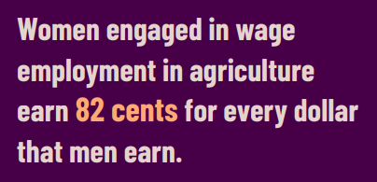
Agrifood systems world context
2023

Slide 6

Agrifood Systems - EU context
% of economic value (€) corresponding to female farm managers
Female % of regular labor force
The value (€) considers the general characteristics of farms, information on their land, livestock and labor force, production methods, rural development measures and agro-environmental aspects that look at the impact of agriculture on the environment.
Notes:
Data is obtained from Eurostat database.
Note that data is segregated by sex (not gender)

Slide 7
Agrifood Systems - EU context
% of Bachelor female students (2021)
Notes:
Data is obtained from Eurostat database.

Slide 8
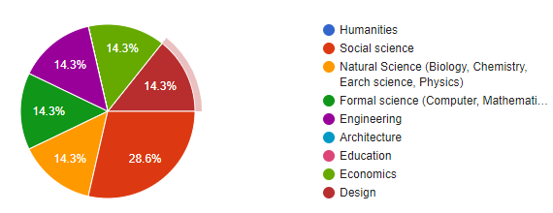
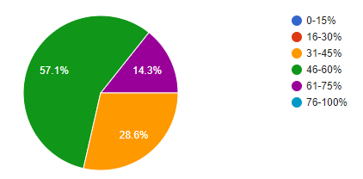
AGRIGEP context
7 answers
Knowledge are (teaching)
Different attitude among students based on gender
% female students
women are more diligent
lower self-confidence of women, distribution of tasks (women-administration, organisation)
different attitudes to learning, different attendance and communication styles
male students tend to participate more in class (asking questions and replying to questions)
Notes:
This data was obtained from the Agrigep survey carried out for the “Gender in the Agrifood teaching” training held in 2024. It is strongly recommended to perform an ex-ante survey of the webinar to adapt this data to the current audience.

Slide 9
Contents
Agrifood systems context
Gender in teaching
Agrifood systems examples
Recommended readings
Final remarks

Slide 10
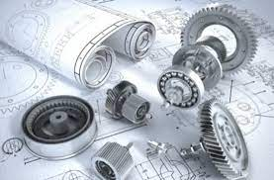
Gender blindness and its implications
Gender-neutral….. or gender-blind?
Masculinization of the professional and academic culture of the discipline
Impact:
Low proportion of female students in engineering
Perpetuation of stereotypes
Under-representation of women in engineering decision-making bodies
Gender-blind research for the society
Notes:
Typically STEM studies have been considered to be gender-neutral (as a positive characteristics!), but when a closer insight is achieved, it becomes evident that they are gender-blinded, yielding to several social impacts.

Slide 11




Gender mainstreaming
The governance bodies, key actors and decision-makers
Recruitment, career progression and retention
Work and personal life integration
Researchers and research: gender equality and sex and gender perspective
Integration of sex and gender dimension in teaching curricula
https://www.plotina.eu/drafting-the-gep/
Notes:
This slide is designed to explain the gender mainstreaming concept. The webinar will focus on teaching, but it is not enough and this gender dimension should also permeate to other aspects of our institutions.

Slide 12
Basic principles
Gender dimension in teaching
Specific subjects
Transversal approach
Bottom-up
Notes:
All along the webinar, a bottom-up approach is followed, where ALL educators CAN include gender dimension in their teaching. Of course, the existence of specific subjects can be interesting, but the real transformation will be achieved if this transversal approach is followed.

Slide 13

Basic principles
Learning outcomes
Gender competence
Utility
Tools, typologies,…
Assessment
Contents
Female referents, biography
Participation
Learning environment
Methodology
Inclusive and non-sexist languages and images
PBL, Service-Learning, debates, role-plays…
Teams, roles, leadership…
Notes:
This is the core of the webinar.
Participants should realize that all four pillars should be colored by the gender dimension, rather that only the contents one. This will facilitate the task and open the door for beginners (the learning environment and the methodology pillars are far easier).

Slide 14
Methodology
Active methodologies (as promoters for human dimension)
Self-efficiency → referent female engineers
Ex ante & ex post → action research
Notes:
No special methodology is here proposed for including the gender dimension, but active learning methodologies provide a favorable context to work with interpersonal skills and, thus, to work on stereotypes and biases. As an example, let's consider a Project Base Learning methodology: usually the project is carried out within a teamwork and then it allows us to deeply work in roles and their corresponding stereotypes (see slide #16). Also, in a role-play one can explicitly discuss on some gendered stereotypes, gendered priorities, etc. These are just two examples but the main points are:
1. Active methodologies force students' interaction and, thus, allows us to explicitly discuss biases and gender stereotypes
2. Active methodologies tend to require multiple assessment instruments (a report, an oral defense, some peer-evaluation, etc), providing students with a more diverse spectra of instruments and, thus, more adapted to each individual.
Low levels of self-efficiency has proven to be one of the barriers for women to enrol in a STEM field. These low levels can be also observed among female STEM students. Thus, we as educators can try to support their self-perception by introducing some female referents.
The ex-ante and ex-post surveys can help us improving the webinar, following an action research methodology.

Slide 15
Learning environment
Female students participation
Gender-sensitive language
Egalitarian visual resources
Teamwork gender distribution and roles
Universitat Politècnica de Catalunya: Third person pronouns
(he/she, him/her → plural they, their, ...)
Notes:
These are some hints on how to include the GD in the learning environment.
An example of a brief language guide from Universitat Politècnica de Catalunya is here proposed, but the facilitator is encouraged to include other guides from their own institution.

Slide 16


Learning environment
Susana Gaytán (2016)
Students’ distribution
Topic (SDG)
Educator’s sustainability
Rotative roles, Leadership, belonging, cooperation
Co/self/-assessment Pre/post-test
PBL & teamwork
Laura Hirshfield & Milo D. Koretsky (2018)
Sarah Hofer (2015)
Carina S. González-González et. al. (2018)
Notes:
This is an example on hoe an active learning methodology where students work in teams can support the inclusion of the GD. There are some references for 3 of the topics that can guide the facilitators and provide some examples for the participants.
The topic, when aligned to the SDG, can enhance the environmental and social impact of the project, what has proven to be of most interest for female students.
Educator’s sustainability, in terms of time resources, is crucial in order to correctly guide the students, provide the appropriate feedback and keep the schedule (and health).

Slide 17

Contents
Survey 2019
548 students
16 courses
7 Bachelor and Master degrees
→ male/female referents
 | Male students | Female students
Male referents | Actual and from the field of study | Belonging from the personal circle
Female referents | Belonging from the personal circle or UPC teaching staff
Notes:
These are results of a UPC (Universitat Politècnica de Catalunya) survey carried out within a teaching innovation project in 2019. Part of this survey was focused on the male and female referents within their area of knowledge.
Gender biases become evident.

Slide 18
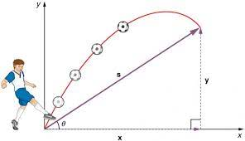
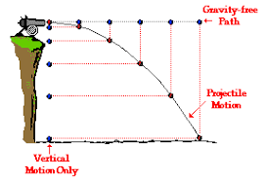
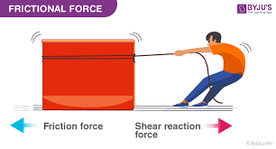
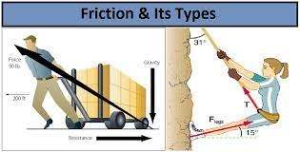
Contents
Fundamentals
Examples: calculus, algebra, physics, statistics…
Focus: contextualization
Google “Parabolic movement”:
Google “Friction force”:
Notes:
The graphs are examples that are typically used to explain physics (either at high school or at the first year of the Bachelor Degree) and it makes evident the urgent need to include gender in these examples. There is always a man doing something related to football, war or non-sense things. Only in the right figure we see some examples of both a man and a women doing specific things that we can relate to our life.
We should try to include significant examples when explaining the fundamentals of any science.

Slide 19
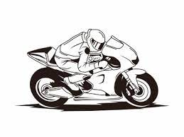
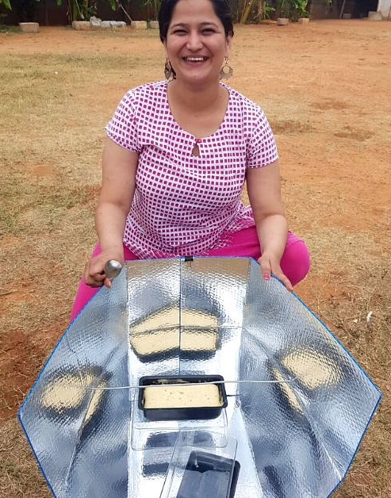



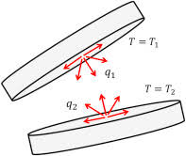
Contents
Technologies
Examples: heat transfer, electrotechnics, …
Focus: + safety, environment, ergonomic, SDG, consumption paths, …
Service-learning: Building improvement: energy, accessibility, acoustics, ventilation, ...
Notes:
A technology can be explained on an object-oriented basis or can include some focus on the humans that are going to use it, the environmental impacts, the social impacts, ....
Statistics show that female are more interested in environment and in social aspects, so we should try to colour STEM studies with this very useful aspects.

Slide 20
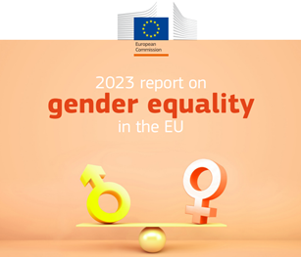
Contents
Management
Examples: projects, organization, human resources, …
Focus: + + gender in interpersonal relationships, recruitment, work-life balance, …
Discussions regarding gender gaps and biases in the selection processes and promotion
Notes:
The management subjects are strongly related to persons, workers and users. So the GD must be included in all of their contents.

Slide 21
Contents
Fundamentals
Examples: calculus, algebra, physics, statistics…
Focus: contextualization
Technologies
Examples: heat transfer, electrotechnics, …
Focus: + safety, environment, ergonomic, SDG, consumption paths, …
Management
Examples: projects, organization, human resources, …
Focus: + + gender in interpersonal relationships, recruitment, work-life balance, …

Slide 22
Assessment
Is it relevant? Then, it must be assessed
Tools:
Open question or multiple-choice test?
Contextualised questions
Types:
formative, feedback
Pros & cons of co/self-assessment
Student involvement: when, how, why
Unconscious bias by the educator!
Notes:
If we really trust that GD is relevant (in any of the 4 pillars), we should assess it.
There’s a lot of literature regarding the GD in the definition of the instruments. Refer to chapter 4 of (Mas de les Valls & Peña, 2022) for a brief summary.

Slide 23
Contents
Agrifood systems context
Gender in teaching
Agrifood systems examples
Recommended readings
Final remarks
Notes:
In the following slides some examples are provided. They are presented as part of research studies, what indicates that they can easily be included within a PBL methodology.
Be sure that the key aspects for each example are not explained at the very beginning. Start asking the audience how would they relate each example with one or more of the 4 pillars.

Slide 24
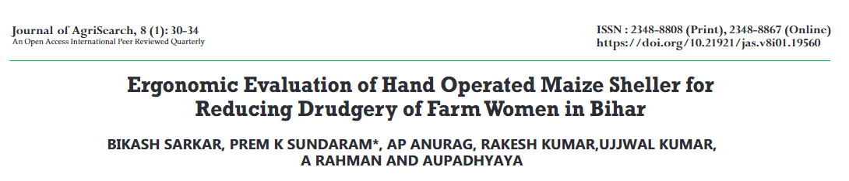
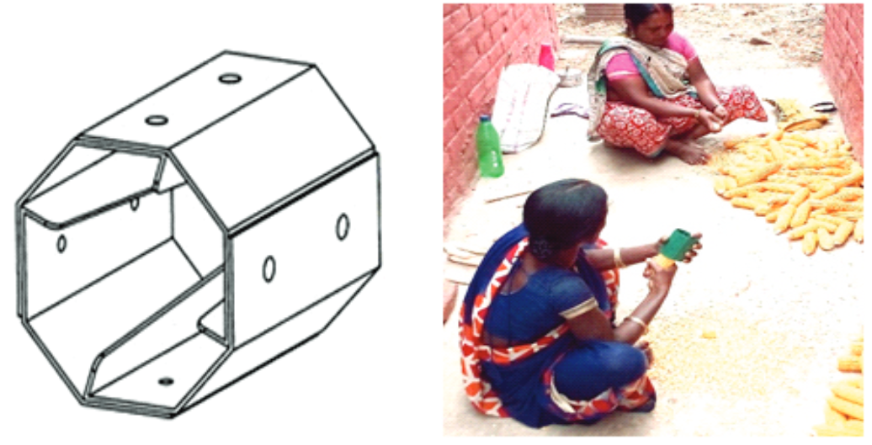


Subject: machinery & mechanization
Enginyeries Agraries: guies per a una docència universitària amb perspectiva de gènere. Raigón Jiménez, María Dolores (Xarxa Vives d'Universitats, 2022)
Notes:
In this research study it can be observed that improving the design of a tool has social consequences, sometimes, far beyond the first impression.
In the example, the new design of the Hand Operated Maize Sheller changed the life of a specific sector of the population: farm women. If we do not analyze the users of our designs (or target population) and the impact of our designs on their life with a gender perspective, we will miss the real impact of our engineering solutions.
Often, just the opposite scenario occurs: many engineering solutions benefit more men than women and, since no gender perspective is included, the gender inequalities persist.
Note that the link to the journal paper is included as an hyperlink on the image.

Slide 25
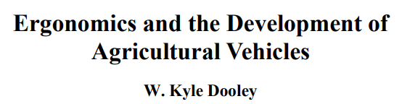
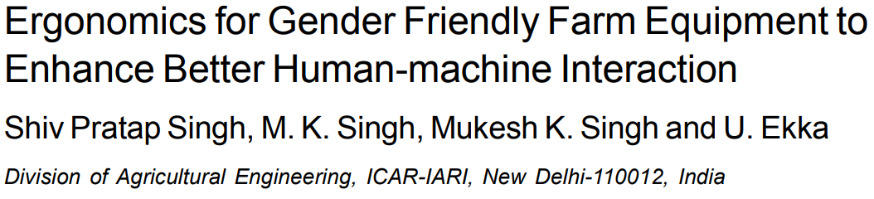

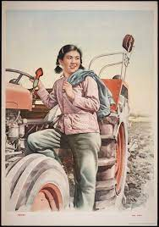
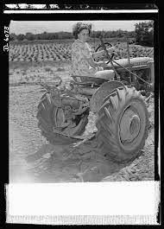
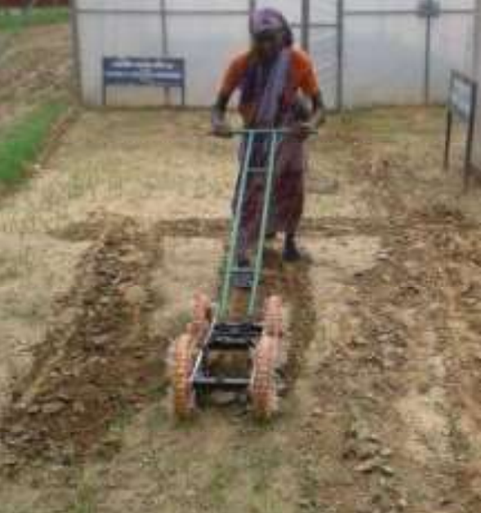

Subject: machinery & mechanization
The best possible ergonomic match maximizes an operator’s effectiveness, comfort and system safety. For every ergonomic mismatch, you are deducting from your ideal productivity, costing time and money.
Notes:
A topic within agrifood systems where the users' sex (not gender) is a relevant variable is ergonomics.
These research papers focus the attention into the ergonomics of agricultural vehicles. If the design considers only the typical heigh and weight of white middle-aged males, a significant sector of the users are not taken into account. Then, surprising scenarios might appear, as that where the security system blocked a female to drive a tractor assuming she was a kid.
In ergonomics, if the users' sex is not taken as a design variable, a bias in the design will exist.
Note that the links to the journal papers are included as hyperlinks on the images.

Slide 26
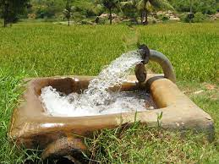
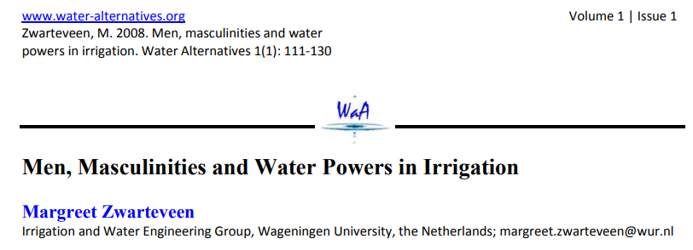

Subject: irrigation engineering
Enginyeries Agraries: guies per a una docència universitària amb perspectiva de gènere. Raigón Jiménez, María Dolores (Xarxa Vives d'Universitats, 2022)
Notes:
Imbalanced power distribution is usually not discussed in class, but the consequences of it are huge. Agrifood professionals should have this holistic view of the field of knowledge and try to reduce existing biases.
In the example it is studied how the fact that the water management is decided by a males' population, their decisions are biased and gender inequalities persist. Also, the concept of gender-neutrality and its risks is commented.
Note that the link to the journal paper is included as an hyperlink on the image.

Slide 27

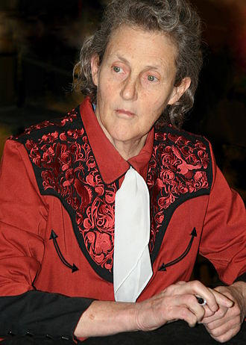
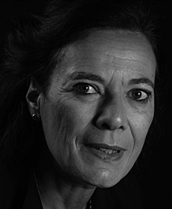

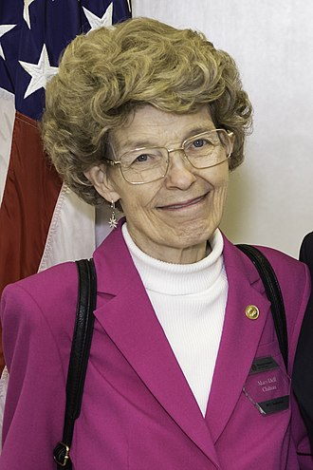


Female role-models
Mary Temple Grandin (1947)
Her innovative designs for livestock handling facilities have revolutionized the way animals are handled and processed in the agricultural sector.
Louise Fresco (1952)
Her work focuses on the intersection of science, technology, and society, particularly in the context of food production.
Mary-Dell Chilton (1939)
Her work on plant genetic engineering has been instrumental in the development of genetically modified crops, significantly impacting the agro-food industry.
Notes:
These are female role-models within agrifood context. One of the activities to include a gender dimension in the teaching consists in making visible the contributions of women in the knowledge area.
The existence of awards and recognitions is something that puts in value all the efforts that are being carried out in empowering female within agrifood context. Commenting on it at class can rise awareness and become a source of debate.

Slide 28
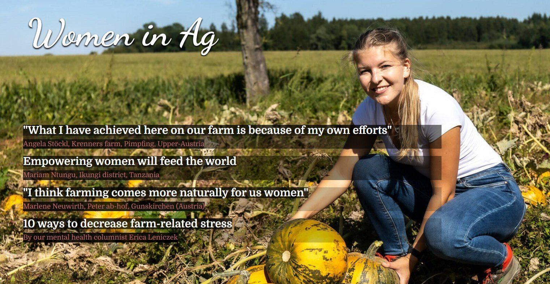
Female role-models
2023 (3)

Slide 29
Contents
Agrifood systems context
Gender in teaching
Agrifood systems examples
Recommended readings
Final remarks

Slide 30
Recommended readings
Top 10 reads on women’s work in agri-food systems, Niyati Singaraju, CGIAR GENDER Impact Platform, 28th June 2023
Enginyeries Agraries: guies per a una docència universitària amb perspectiva de gènere. Raigón Jiménez, María Dolores. Xarxa Vives d'Universitats, 2022
Agricultural Studies. Syllabus by Prof. Dr. Christine Bauhardt, M.A. Meike Brückner, July 2018
Toolkit for Integrating Gender-Sensitive Approach into Research and Teaching, Jovana Mihajlovic Trbovc and Ana Hofman, Garcia Working Papers n. 6, 2015
Gender equality in academia and research. GEAR tool, European Institute for Gender Equality, 2016
A guide for Gender Equality in Teaching Education Policy and Practices, United Nations Educational, Scientific and Cultural Organization, 2015
Guide of Industrial Engineering to mainstreaming gender in university teaching, Elisabet Mas de les Valls and Marta Peña, Xarxa Vives d’universitats, 2020
Notes:
If desired, extend the list of recommended readings.

Slide 31








Guides of the Vives University Network (Spain)
First guides published in 2018. At present: 29 guides (11 in STEM fields)
Recognized by the European Institute for Gender Equality (EIGE) as an example of good practice in its GEAR Toolkit
Agricultural engineering (2022)
Notes:
Enhance the fact that guides not focused on agrifood can also be useful.

Slide 32
Contents
Agrifood systems context
Gender in teaching
Agrifood systems examples
Recommended readings
Final remarks

Slide 33
Final remarks
The agrifood context is still male dominated → actions are required.
Gender dimension can be included in all subjects (4 pillars).
Guides and tools are widely available.
Resistances will appear → introduce the changes gradually, in a natural way and participate in hands-on trainings to get more insight.

Slide 34
Exit questionnaire
Your opinion is important to us!
QR code or short link

Slide 35
Gender in Agrifood Systems Teaching
Date
Facilitator’s name and email address
Notes:
After the introduction of the facilitator and a brief presentation of the Agrigep project (to be designed by the facilitator if considered), it is recommended to highlight some EU policies that show the relevance of the topic from a decision-making point of view. Some key EU policies:
1995 Beijing conference where the word ‘gender’ appeared for the first time,
2007 Council of Europe issued a recommendation on gender mainstreaming in education,
2015 Paris declaration and Commission/Council for non-discrimination,
2015 launched and adopted the European Framework for Education 2030 equal opportunity for all, guidelines started to appear
Be sure that the audience know the difference between sex and gender.

